Slide 1
Exercise Break App
Ash Kandari, Ben Deschand, Nilesh Jain, Soham Sachin Pradhan
Group 29

Slide 2
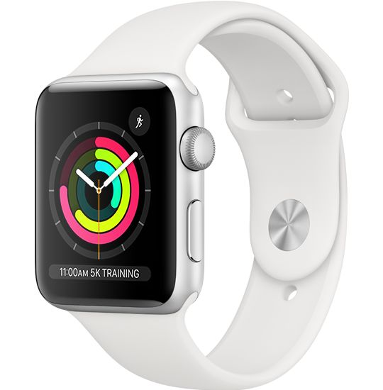
What is Exercise Break App?
The idea of this app is to use the heartbeat sensor technology found in most smart watches to calculate and find the optimal time to take a break and either get a drink or use its GPS to find a place that could sell a sports drink. This way the user takes a break at the optimal time on their bike ride or run to take a break to steady their heart rate and rehydrate during the trip.

Slide 3
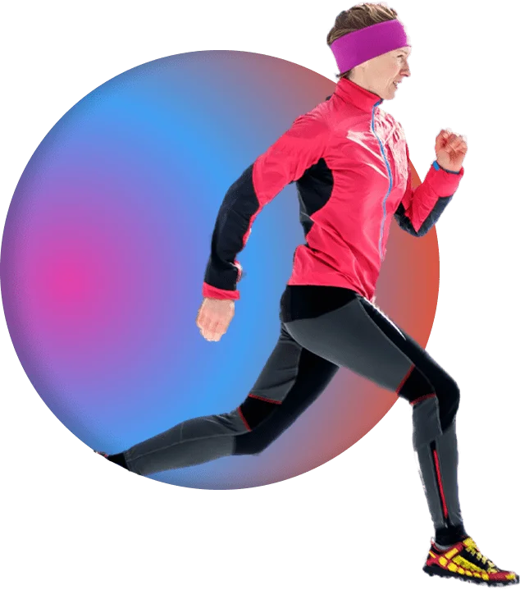
What is the goal of the project
This app was made with the intention of helping endurance trainers to those who just want to go on jog to have a better exercise experience. The hope is by making endurance exercise more fun and less strenuous, they will feel more inclined to do these types of exercises and foster healthier habits.

Slide 4
How does it work?
To start, when the user first gets the app, they create an account for themselves to be stored in a server. This allows for the client’s information to be used on any device they want to use when they sign in. They will next put in personal information such as height, weight, and the level of exercise they are currently doing. The software will use that information to calculate both the rate of calorie loss and the correct heartbeat level to use when creating the break.
Before the user decides to leave to start their trip, they will put in what type of exercise they will be participating in, whether it be running or biking or something of that sort, and what drinks they will be bringing with them. It will use basic data about the nutritional statistics about generic version of drinks (water, sports drinks, etc.) to understand the calorie replenishment that is supplied. With this ready, the user selects a button that starts tracking the heartbeat and starts their exercise trip.

Slide 5
How does it work? cont.
When the smartwatch’s heartbeat sensor finds the heartbeat at an unsatisfactorily high rate, the watch or the phone will gently buzz to alert the user. The user should then use this warning to slow down and stop in the closest appropriate area to rest. The user should then stop and take a drink while the heartbeat sensor continually watches the heart rate. When the heart rate has reduced to an acceptable level it will ask the user if they had used up their drink and tells the user they are now ready to go.
If the user doesn’t have a drink anymore and they are nearing the heart rate that would alert the user to take a break, the software will now look for a place to replenish their calories. It will use the GPS found in the smartwatch or the phone and a general map to locate the closest store to the user. It will then calculate a route using known roadways to find the fastest route there. It will then alert the user when their heart rate reaches a certain number and show them the path to said store. Then when the user arrives at the store, the software will then go back to the basic break function it has where it waits for the user’s heart rate to lower.

Slide 6
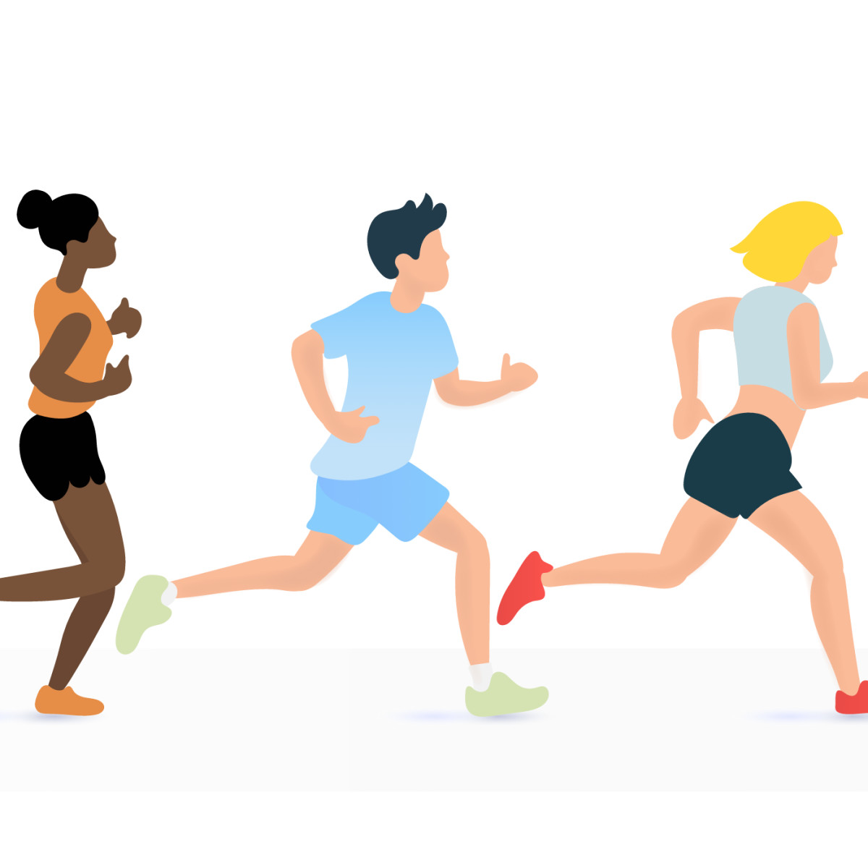
Who is it targeted to?
The application is targeted the general public who wants to participate in endurance exercise, but can also be used for professional purposes like for athletes and their training regime. It can help those starting off with creating healthy habits while those who are more experienced can use it to make sure they don’t overexert themselves.

Slide 7
Competing products
Map My Run
Has millions of routes to try and records the distance traveled, calories burned, and more
Adidas Running App by Runtastic
Easy tracking and stores your run data
Pumatrac
Uses outside information and previous runs to give insight on the perfect time to run
Nike Run Club
Allows you to share your personal goals with friends
Couch to 5k
Made to help beginners start running

Slide 8
References
https://www.asurion.com/connect/tech-tips/top-10-running-apps-for-ios-and-android/
https://www.forbes.com/health/body/best-fitness-apps/

Slide 9
Thank You

